Slide 1
Bootstrap
BY OSS CLUB AIT

Slide 2
Topics to be covered
Introduction to Bootstrap
Linking bootstrap CSS and Javascript
Download bundle
Container
Introduction to bootstrap grid
Break-points/ Resposiveness

Slide 3
Bootstrap is a framework to
help you design websites
faster and easier. It includes
HTML and CSS based design
templates for typography,
forms, buttons, tables,
navigation, modals, image
carousels, etc. It also gives
you support for JavaScript
Plugins.

Slide 4
Getting Started with Bootstrap
There are two ways to start using Bootstrap on your own web site.
You can:
Download Bootstrap from getbootstrap.com.
Include Bootstrap from a CDN. (Content Delivery Network)

Slide 5
Download Bundles
Include every Bootstrap JavaScript plugin and dependency with one of our two bundles. Both bootstrap.bundle.js and bootstrap.bundle.min.js include Popper
for our tooltips and popovers.
<script src="https://cdn.jsdelivr.net/npm/bootstrap@5.1.3/dist/js/bootstrap.bundle.min.js" integrity="sha384-ka7Sk0Gln4gmtz2MlQnikT1wXgYsOg+OMhuP+IlRH9sENBO0LRn5q+8nbTov4+1p" crossorigin="anonymous"></script>

Slide 6
Container
Containers are the most basic layout element in Bootstrap and are required when using our default grid system. Choose from a responsive, fixed-width container (meaning its max-width changes at each breakpoint) or fluid-width (meaning it’s 100% wide all the time).
While containers can be nested, most layouts do not require a nested container.

Slide 7
Bootstrap Grid
Bootstrap's grid system is built with flexbox and allows up to 12 columns
across the page.
If you do not want to use all 12 columns individually, you can group the
columns together to create wider columns.
The grid system is responsive, and the columns will re-arrange
automatically depending on the screen size.
Make sure that the sum adds up to 12 or fewer (it is not required that you
use all 12 available columns).

Slide 9
Break-Points/Responsiveness
Breakpoints are the building blocks of responsive design.
We use them to control when the layout can be adapted at a particular viewport or device size.
Bootstrap includes six default breakpoints, sometimes referred to as grid tiers, for building responsively. These breakpoints can be customized if you’re using our source Sass files

Slide 10
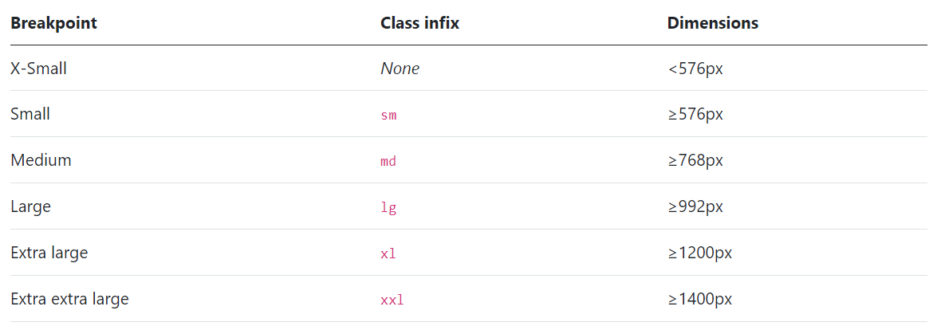
Available Break-points

Slide 11
Doubts

Slide 12
THANK YOU
BY OSS CLUB AIT

